Slide 1
Parallel and Distributed Computing
CS3006
Lecture 7
Mapping Schemes

Slide 2
Characteristics of Tasks
Once a problem has been decomposed into independent tasks, the characteristics of these tasks critically impact choice and performance of parallel algorithms. Relevant task characteristics include:
Task generation.
Task sizes.
Size of data associated with tasks.

Slide 3
Task Generation
Static task generation: Concurrent tasks can be identified a-priori. Typical matrix operations, graph algorithms, image processing applications, and other regularly structured problems fall in this class. These can typically be decomposed using data or recursive decomposition techniques.
Dynamic task generation: Tasks are generated as we perform computation. A classic example of this is in game playing - each 15 puzzle board is generated from the previous one. These applications are typically decomposed using exploratory or speculative decompositions.

Slide 4
Task Sizes
Task sizes may be uniform (i.e., all tasks are the same size) or non-uniform.
Non-uniform task sizes may be such that they can be determined (or estimated) a-priori or not.
Examples in this class include discrete optimization problems, in which it is difficult to estimate the effective size of a state space.

Slide 5
Size of Data Associated with Tasks
The size of data associated with a task may be small or large when viewed in the context of the size of the task.
A small context of a task implies that an algorithm can easily communicate this task to other processes dynamically (e.g., the 15 puzzle).
A large context ties the task to a process, or alternately, an algorithm may attempt to reconstruct the context at another processes as opposed to communicating the context of the task (e.g., 0/1 integer programming).

Slide 6
Characteristics of Task Interactions
Tasks may communicate with each other in various ways. The associated dichotomy is:
Static interactions: The tasks and their interactions are known a-priori. These are relatively simpler to code into programs.
Dynamic interactions: The timing or interacting tasks cannot be determined a-priori. These interactions are harder to code, especitally, as we shall see, using message passing APIs.

Slide 7
Characteristics of Task Interactions
Regular interactions: There is a definite pattern (in the graph sense) to the interactions. These patterns can be exploited for efficient implementation.
Irregular interactions: Interactions lack well-defined topologies.

Slide 8
Characteristics of Task Interactions: Example
A simple example of a regular static interaction pattern is in image dithering. The underlying communication pattern is a structured (2-D mesh) one as shown here:

Slide 9
Characteristics of Task Interactions: Example
The multiplication of a sparse matrix with a vector is a good example of a static irregular interaction pattern. Here is an example of a sparse matrix and its associated interaction pattern.

Slide 10
Characteristics of Task Interactions
Interactions may be read-only or read-write.
In read-only interactions, tasks just read data items associated with other tasks.
In read-write interactions tasks read, as well as modily data items associated with other tasks.
In general, read-write interactions are harder to code, since they require additional synchronization primitives.

Slide 11
Characteristics of Task Interactions
Interactions may be one-way or two-way.
A one-way interaction can be initiated and accomplished by one of the two interacting tasks.
A two-way interaction requires participation from both tasks involved in an interaction.
One way interactions are somewhat harder to code in message passing APIs.

Slide 12
Mapping Techniques
Once a problem has been decomposed into concurrent tasks, these must be mapped to processes (that can be executed on a parallel platform).
Mappings must minimize overheads.
Primary overheads are communication and idling.
Minimizing these overheads often represents contradicting objectives.
Assigning all work to one processor trivially minimizes communication at the expense of significant idling.

Slide 13
Mapping Techniques for Minimum Idling
Mapping must simultaneously minimize idling and load balance. Merely balancing load does not minimize idling.

Slide 14
Mapping Techniques for Minimum Idling
Mapping techniques can be static or dynamic.
Static Mapping: Tasks are mapped to processes a-priori. For this to work, we must have a good estimate of the size of each task. Even in these cases, the problem may be NP complete.
Dynamic Mapping: Tasks are mapped to processes at runtime. This may be because the tasks are generated at runtime, or that their sizes are not known.
Other factors that determine the choice of techniques include the
size of data associated with a task and the nature of underlying
domain.

Slide 15
Schemes for Static Mapping
Mappings based on data partitioning.
Mappings based on task graph partitioning.
Hybrid mappings.

Slide 16
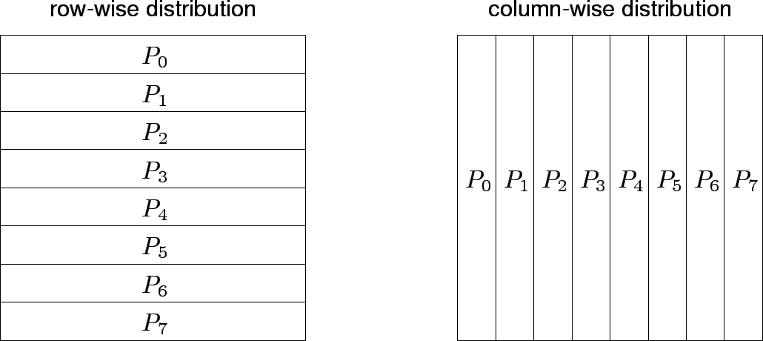
Mappings Based on Data Partitioning
We can combine data partitioning with the ``owner-computes'' rule to partition the computation into subtasks. The simplest data decomposition schemes for dense matrices are 1-D block distribution schemes.

Slide 17
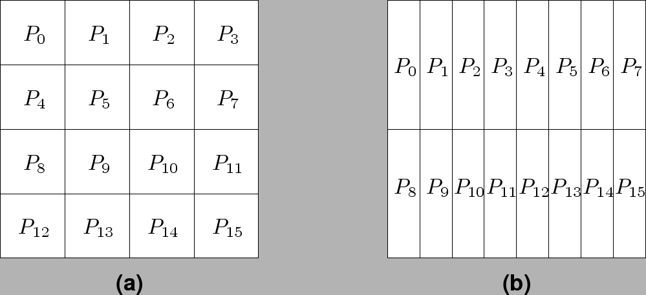
Block Array Distribution Schemes
Block distribution schemes can be generalized to higher dimensions as well.

Slide 18
Block Array Distribution Schemes: Examples
For multiplying two dense matrices A and B, we can partition the output matrix C using a block decomposition.
For load balance, we give each task the same number of elements of C. (Note that each element of C corresponds to a single dot product.)
The choice of precise decomposition (1-D or 2-D) is determined by the associated communication overhead.
In general, higher dimension decomposition allows the use of larger number of processes.

Slide 19
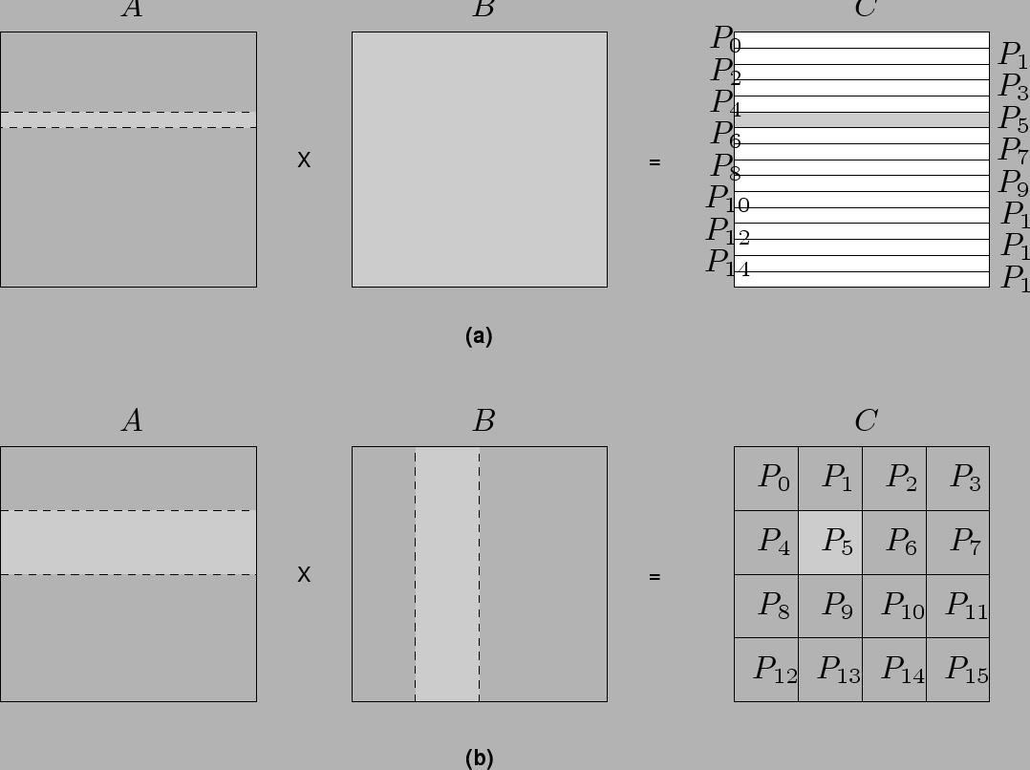
Data Sharing in Dense Matrix Multiplication

Slide 20
Cyclic and Block Cyclic Distributions
If the amount of computation associated with data items varies, a block decomposition may lead to significant load imbalances.
A simple example of this is in LU decomposition (or Gaussian Elimination) of dense matrices.

Slide 21
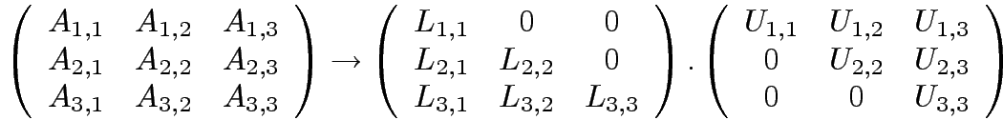














LU Factorization of a Dense Matrix
A decomposition of LU factorization into 14 tasks - notice the
significant load imbalance.
1: 2: 3: 4: 5: | 6: 7: 8: 9: 10: | 11: 12: 13: 14:

Slide 22
Block Cyclic Distributions
Variation of the block distribution scheme that can be used to alleviate the load-imbalance and idling problems.
Partition an array into many more blocks than the number of available processes.
Blocks are assigned to processes in a round-robin manner so that each process gets several non-adjacent blocks.

Slide 23
Block-Cyclic Distribution for Gaussian Elimination
The active part of the matrix in Gaussian Elimination changes. By assigning blocks in a block-cyclic fashion, each processor receives blocks from different parts of the matrix.

Slide 24
Block-Cyclic Distribution: Examples
One- and two-dimensional block-cyclic distributions among 4 processes.

Slide 25
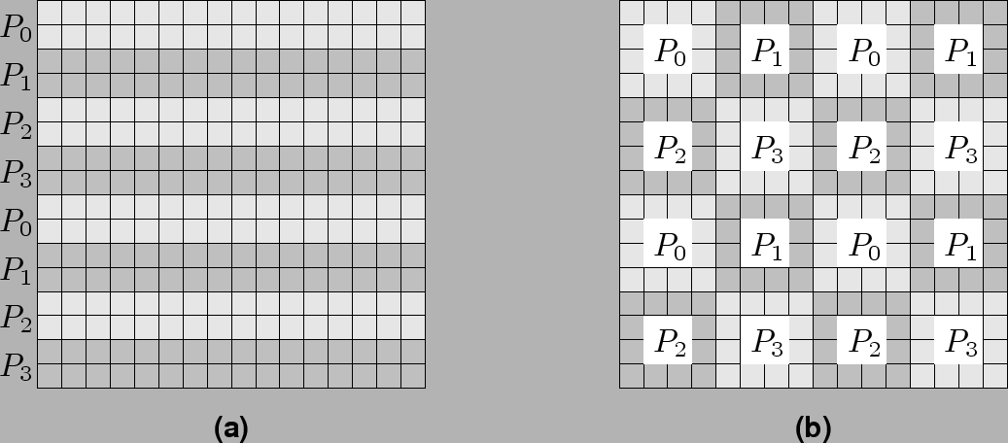
Block-Cyclic Distribution
A cyclic distribution is a special case in which block size is one.
A block distribution is a special case in which block size is n/p , where n is the dimension of the matrix and p is the number of processes.

Slide 26
Graph Partitioning Dased Data Decomposition
In case of sparse matrices, block decompositions are more complex.
Consider the problem of multiplying a sparse matrix with a vector.
The graph of the matrix is a useful indicator of the work (number of nodes) and communication (the degree of each node).
In this case, we would like to partition the graph so as to assign equal number of nodes to each process, while minimizing edge count of the graph partition.

Slide 27
Partitioning the Graph of Lake Superior
Random Partitioning
Partitioning for minimum edge-cut.

Slide 28
Mappings Based on Task Paritioning
Partitioning a given task-dependency graph across processes.
Determining an optimal mapping for a general task-dependency graph is an NP-complete problem.
Excellent heuristics exist for structured graphs.

Slide 29
Task Paritioning: Mapping a Binary Tree Dependency Graph
Example illustrates the dependency graph of one view of quick-sort
and how it can be assigned to processes in a hypercube.

Slide 30
Task Paritioning: Mapping a Sparse Graph
Sparse graph for computing a sparse matrix-vector product and its mapping.

